Slide 1
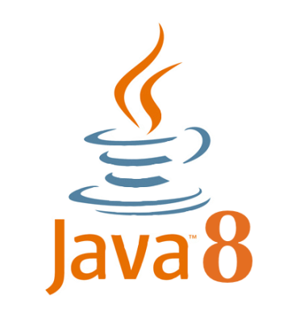




SOFTWARE SETUP
Java Development Kit (JDK)
Eclipse IDE
Apache Tomcat Server
MySQL Database Server
MySQL Workbench

Slide 2
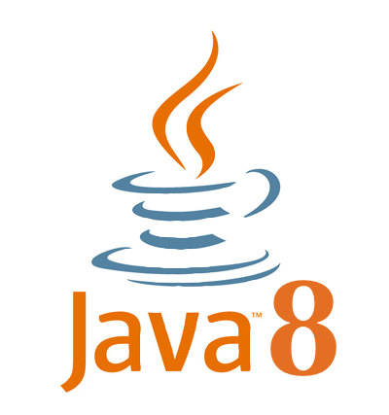
Java Development Kit Setup
Download JDK 8:
http://www.oracle.com/technetwork/java/javase/downloads/jdk8-downloads-2133151.html
Install JDK 8
Set JAVA_HOME system variable
Check javac and javac commands

Slide 3
Eclipse IDE Setup
Download Eclipse IDE for Java EE Developers (Oxygen M2):
http://www.eclipse.org/downloads/packages/release/Oxygen/M2
Install and Run Eclipse

Slide 4
Apache Tomcat Server Setup
Download Apache Tomcat 9:
https://tomcat.apache.org/download-90.cgi
Install Apache Tomcat 9
Start Server & Check Homepage

Slide 5
MySQL Database Server Setup
Download MySQL Community Server:
https://dev.mysql.com/downloads/mysql/
Install MySQL Database Server
Start Server & Check Status

Slide 6
MySQL Workbench Setup
Download MySQL Workbench:
https://dev.mysql.com/downloads/workbench/
Install
Run & Connect to MySQL Server

